Slide 1
Sentiment Analysis System for E-commerce Product Reviews
10Alytics Internship
Team Alpha

Slide 2
Goals
Develop a robust and automated sentiment analysis system tailored for product reviews in the Electronics category on AliExpress.
Efficiently process and interpret large volumes of customer feedback to provide valuable insights for product improvements, marketing strategies, and enhanced customer satisfaction.

Slide 3
Process
Web Scraping : Beautiful Soup, Scrapy - Extract more than 400,000 rows of text reviews and star ratings from Amazon
Cloud Infrastructure
Pipeline Development : for extraction, cleaning, transformation, and loading
Data cleaning : Stopwords, Stemming, Tokenization
Model used : Bag of Words, TF-IDF, Logistic Regression, Naive Bayes, Vader, Confusion Matrix
Tracking and Documentation : SRUM Approach - catalogs, spreadsheets

Slide 4

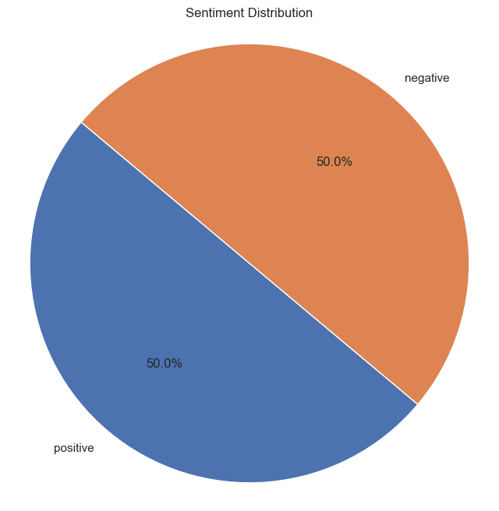
Process
Pie chart for the sentiment Distribution

Slide 5
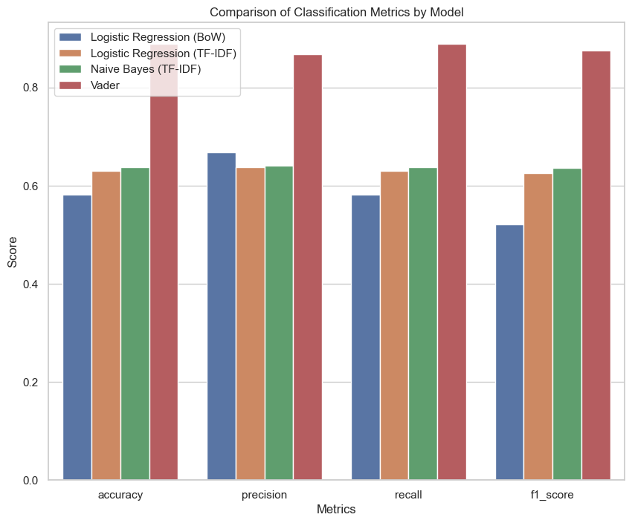
Comparison of classification Metrics by Model

Slide 6
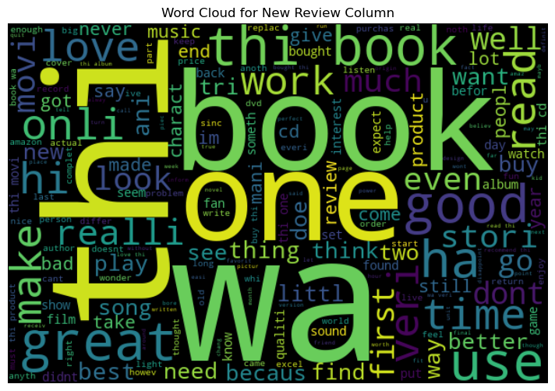
WORD CLOUD FOR CUSTOMER REVIEW

Slide 7
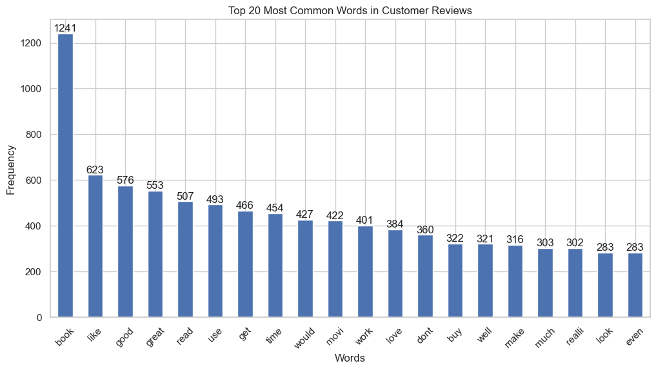
TOP 20 MOST COMMON WORDS IN CUSTOMER REVIEWS

Slide 8
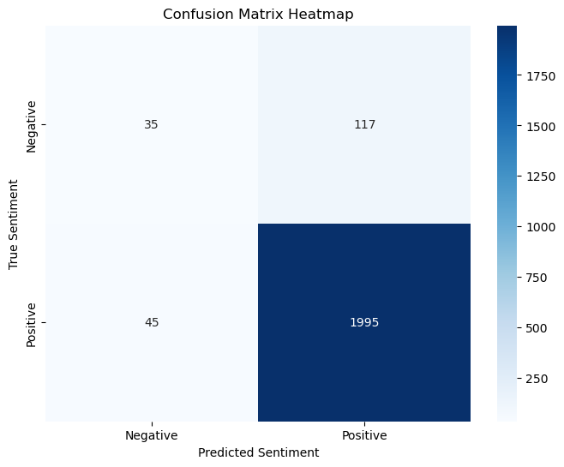
Model Evaluation
Confusion Matrix
True Positives (TP): The model correctly predicted 1995 positive sentiments.
True Negatives (TN): The model correctly predicted 35 negative sentiments.
False Positives (FP): The model incorrectly predicted 117 negative sentiments as positive.
False Negatives (FN): The model incorrectly predicted 45 positive sentiments as negative.

Slide 9
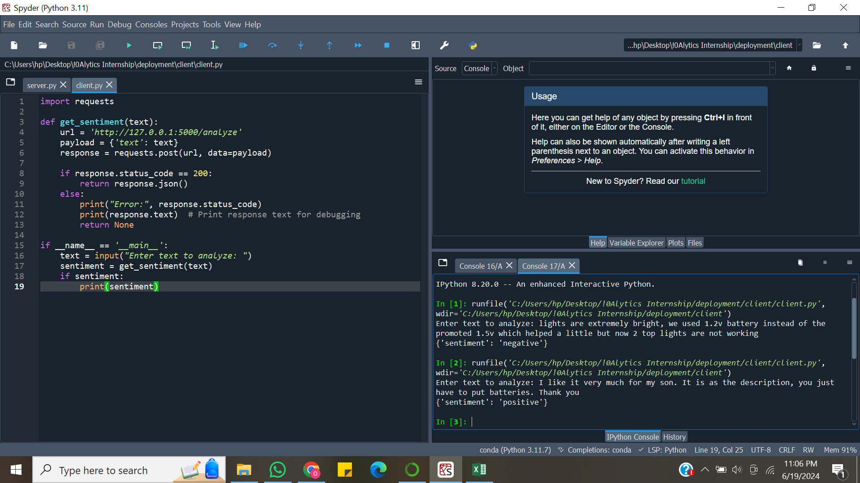
Deployment

Slide 10
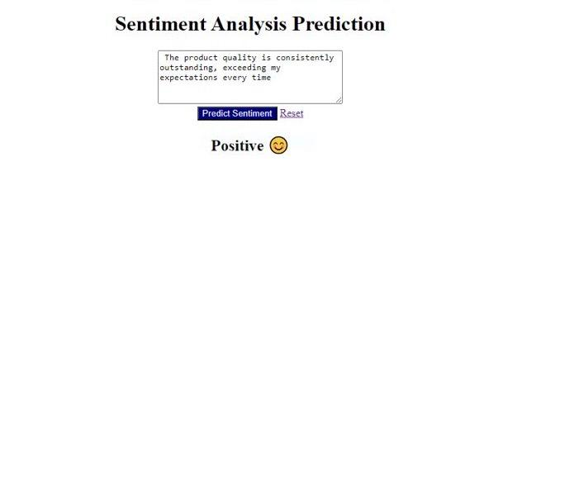
Deployment
Sentiment Analysis
Prediction

Slide 11

THANK YOU FOR YOUR ATTENTION

